Slide 1
BOTTLE-DORA Check-in
July 8, 2024
Stefan Pate, Christina Thaggard, …
BOTTLE Confidential

Slide 2
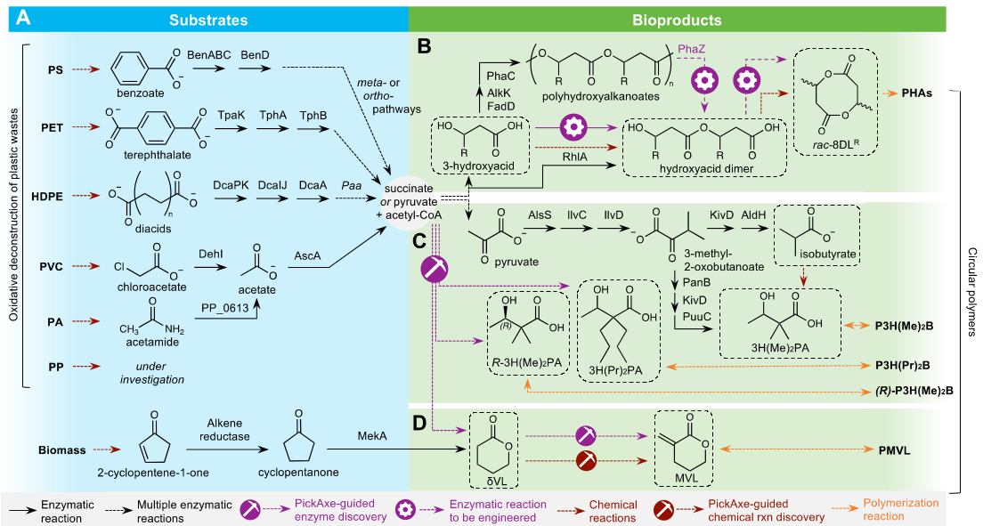
CASP can generate synthesis ideas for novel monomers
Allison Werner

Slide 3
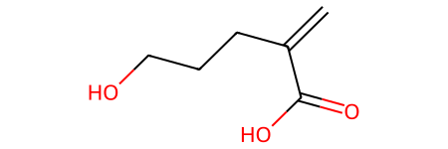
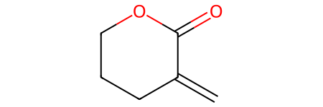
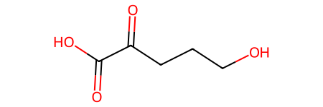
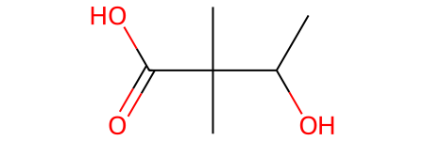
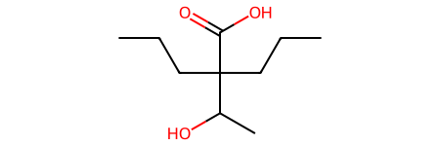
Overview of CASP with DORAnet
1,2,5-activated bio C5s
2-methylene HA
MVL
Central Carbon Metabolites (~10)
HOPA
Amino Acids (20)
DMMHA
1,2,3-activated bio C4s
DPMHA
C3s? Q for K&L
+ All diol & dicarboxylic acid analogues?

Slide 4
Background: Computationally Aided Synthesis Planning (CASP) with DORAnet

Slide 5



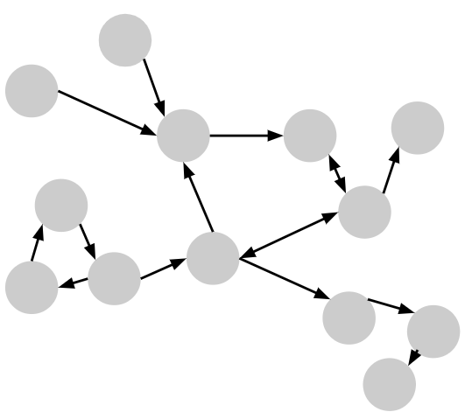
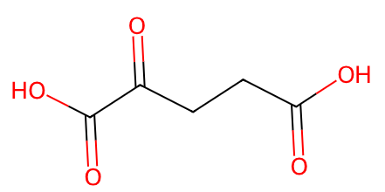
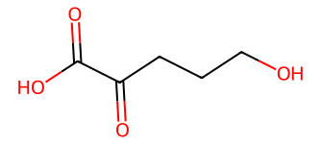
Overview of CASP with DORAnet
D
,
,
→
starting molecules
target molecules
operators

Slide 6
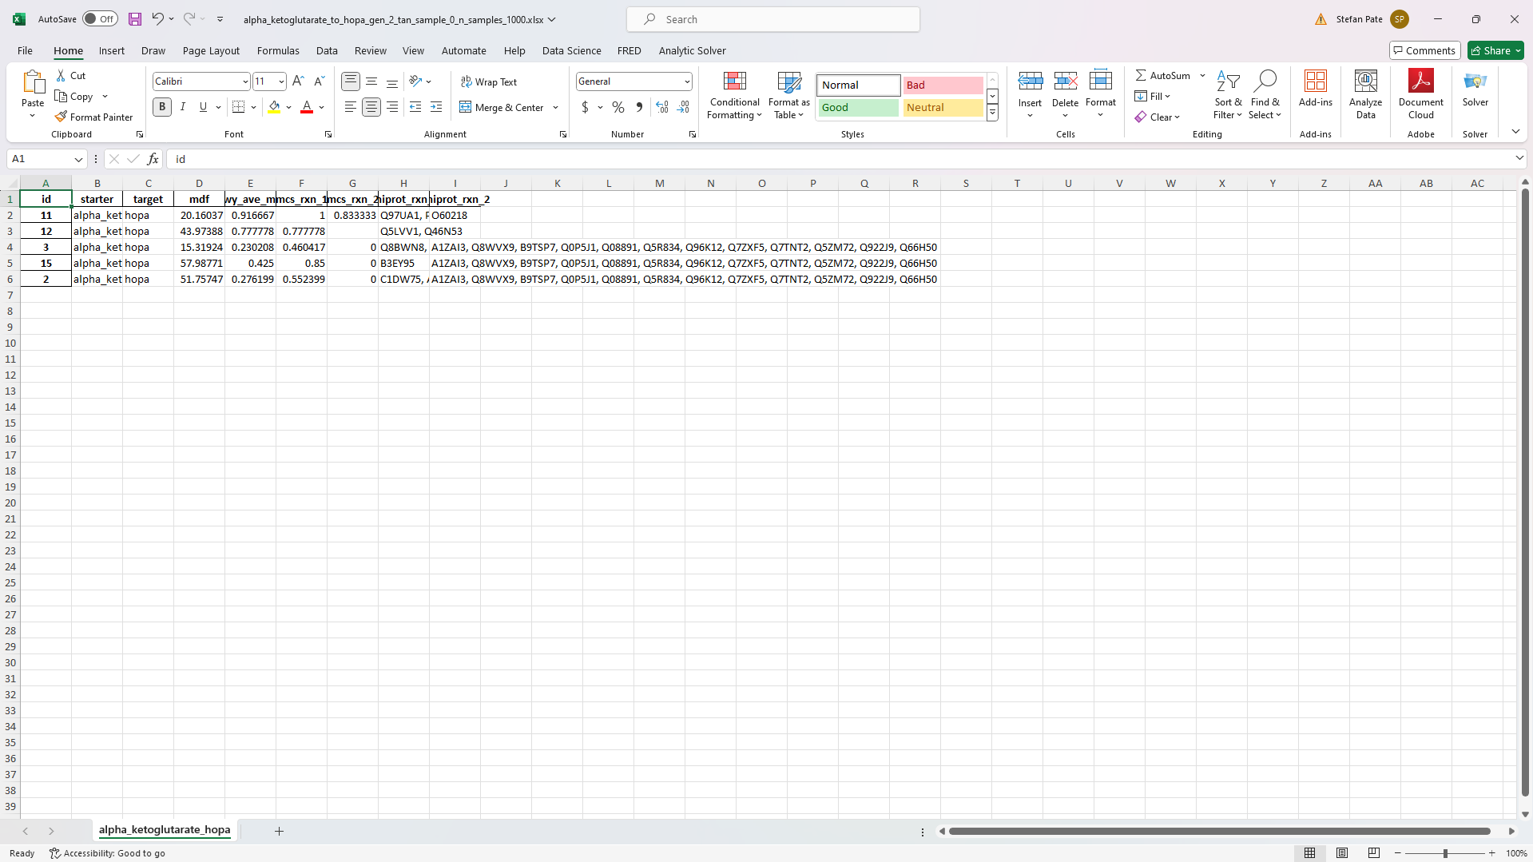
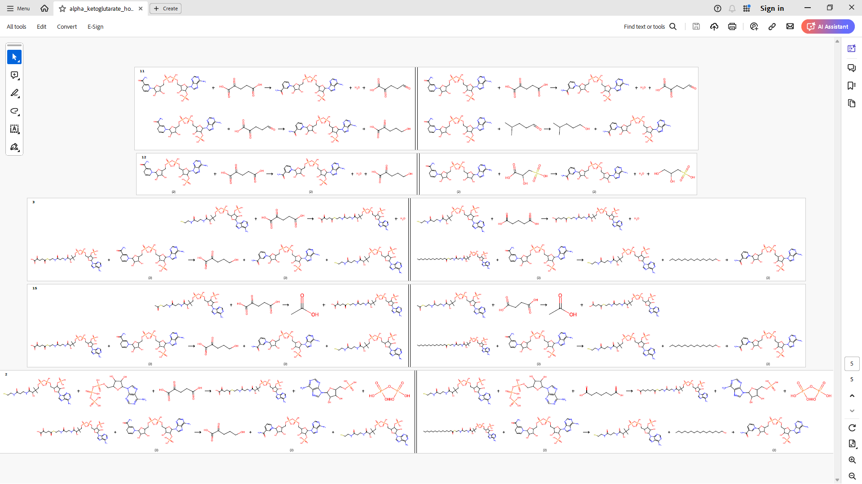
Overview of CASP with DORAnet
1
D
,
,
→
starting molecules
target molecules
operators
2
→
Filtering &
post-processing
→

Slide 7
Overview of CASP with DORAnet
1
D
,
,
→
starting molecules
target molecules
operators
2
→
Filtering &
post-processing
→
Bio
Chem

Slide 8
Overview of CASP with DORAnet
1
D
,
,
→
starting molecules
target molecules
operators
2
→
Filtering &
post-processing
→

Slide 9
Background: Operators

Slide 10
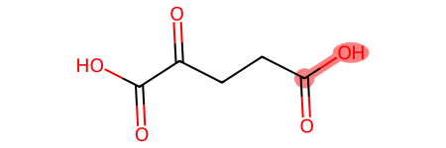
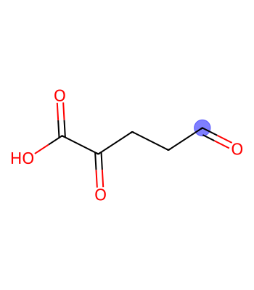
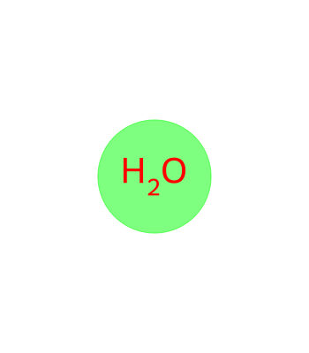
Operators codify & implement chemical transformations in silico
+
NADH
NAD⁺
+
[C:0]-[O:1]>>[C:0].[O:1]

Slide 11
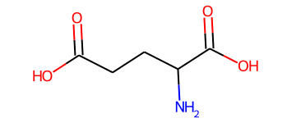
First, let’s consider CASP without operators
Glutamate synthase
(1.4.1.14)
Bio
Chem

Slide 12
First, let’s consider CASP without operators
Glutamate synthase
(1.4.1.14)
This network of known enzymatic reactions is incomplete…
Bio
Chem

Slide 13
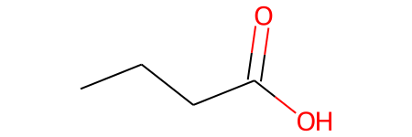
One-enzyme-one-substrate gives way to enzyme promiscuity
ILLUSTRATIVE
Enzyme: NICar
K_{cat} / K_{M}
Tawfik, 2010. Ann. Rev. Biochem.
Arnold, 2018. Ang. Chem. Int.
Bio
Chem

Slide 14
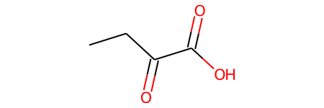
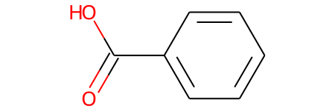
One-enzyme-one-substrate gives way to enzyme promiscuity
ILLUSTRATIVE
Enzyme: NICar
K_{cat} / K_{M}
Substrate structure
Tawfik, 2010. Ann. Rev. Biochem.
Arnold, 2018. Ang. Chem. Int.
Bio
Chem

Slide 15
One-enzyme-one-substrate gives way to enzyme promiscuity
ILLUSTRATIVE
Enzyme: NICar
K_{cat} / K_{M}
Enzymes catalyze reactions on more than one substrate
Catalytic efficiency is similar for structurally similar substrates
Substrate structure
Tawfik, 2010. Ann. Rev. Biochem.
Arnold, 2018. Ang. Chem. Int.
Bio
Chem

Slide 16
One-enzyme-one-substrate gives way to enzyme promiscuity
ILLUSTRATIVE
Enzyme: NICar
K_{cat} / K_{M}
Enzymes catalyze reactions on more than one substrate
Catalytic efficiency is similar for structurally similar substrates
Substrate structure
Tawfik, 2010. Ann. Rev. Biochem.
Arnold, 2018. Ang. Chem. Int.
Bio
Chem

Slide 17
Let’s now look at operators; consider this reaction for example
+
NADH
NAD⁺
+
[C:0]-[O:1]>>[C:0].[O:1]
Bio
Chem

Slide 18
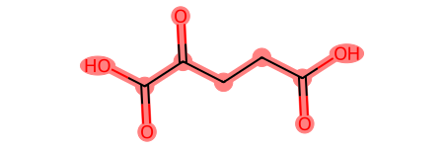
Enzymatic operators codify these two assumptions…
PERMISSIVENESS
CATALYTIC EFFICIENCY
r=inf
substructure:
Bio
Chem

Slide 19
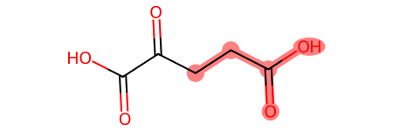
Enzymatic operators codify these two assumptions…
PERMISSIVENESS
CATALYTIC EFFICIENCY
r=inf
r=2
substructure:
Bio
Chem

Slide 20
Enzymatic operators codify these two assumptions…
PERMISSIVENESS
CATALYTIC EFFICIENCY
r=inf
r=2
r=0
substructure:
Bio
Chem

Slide 21
Enzymatic operators codify these two assumptions…
PERMISSIVENESS
CATALYTIC EFFICIENCY
r=inf
r=2
r=0
substructure:
# known compounds w/ matching substructure:
8
3,250
7,759
Bio
Chem

Slide 22
…allowing a search among predicted missing paths
Default enzymatic operators in DORAnet assume intermediate level of promiscuity
Bio
Chem

Slide 23
Chemical Reaction Rules (Operators)
382 chemical rules were curated by hand, two separate lists for forward and retrosynthesis
From organic chemistry textbooks, published papers, etc.
Reaction rules are written in SMARTS (SMILES arbitrary target specification)
Example: Hydrogenation of Alkenes
SMARTS : [C+0:1]=[C+0:2].[H][H]>>[*:1][*:2]
Bio
Chem

Slide 24
Background: Network expansion strategies

Slide 25
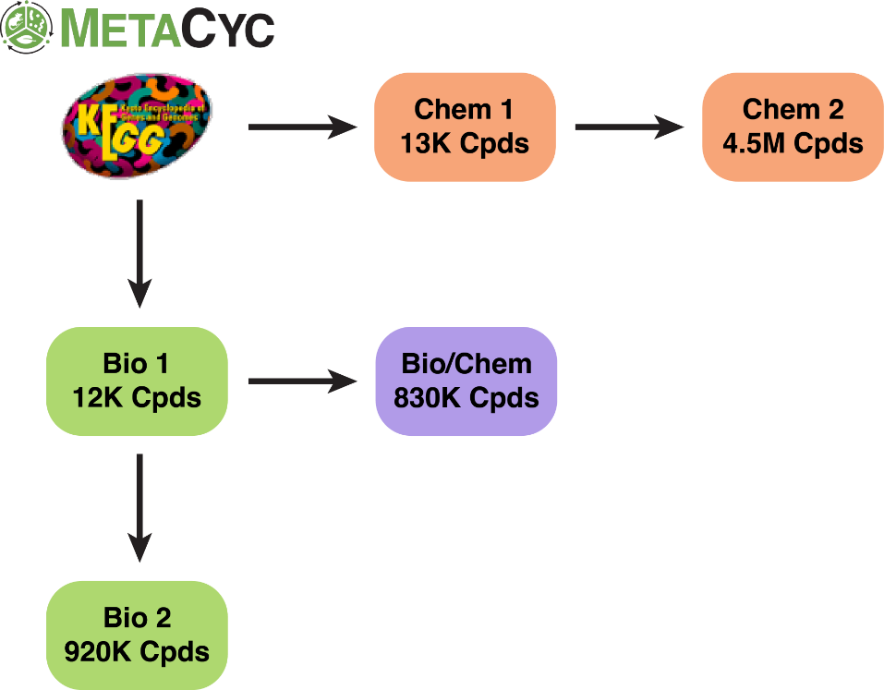
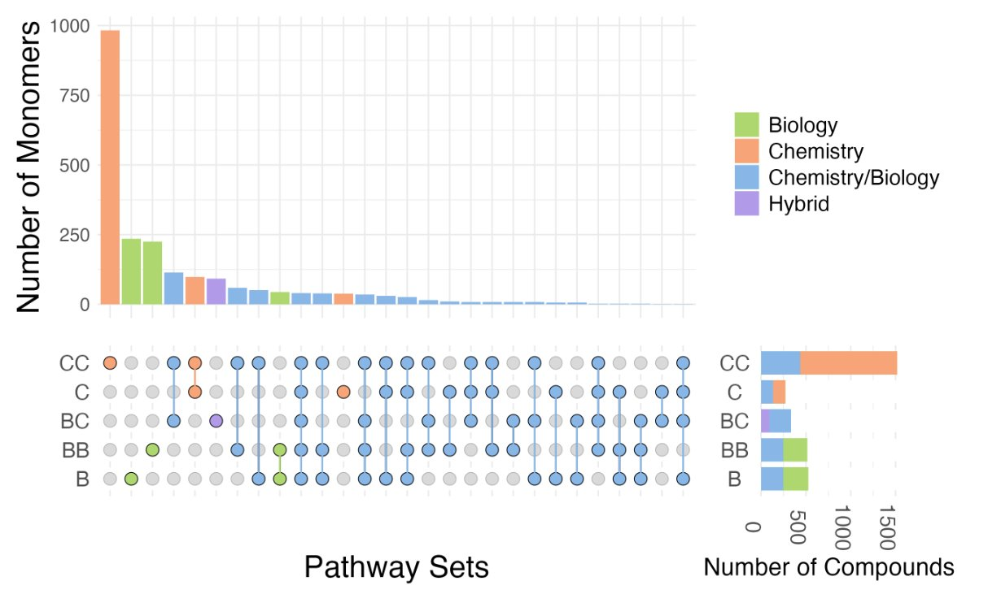
Combining bio & chem operators accesses more molecules
6.3M total compounds generated
2,186 target monomers
Shebek et al., in preparation

Slide 26
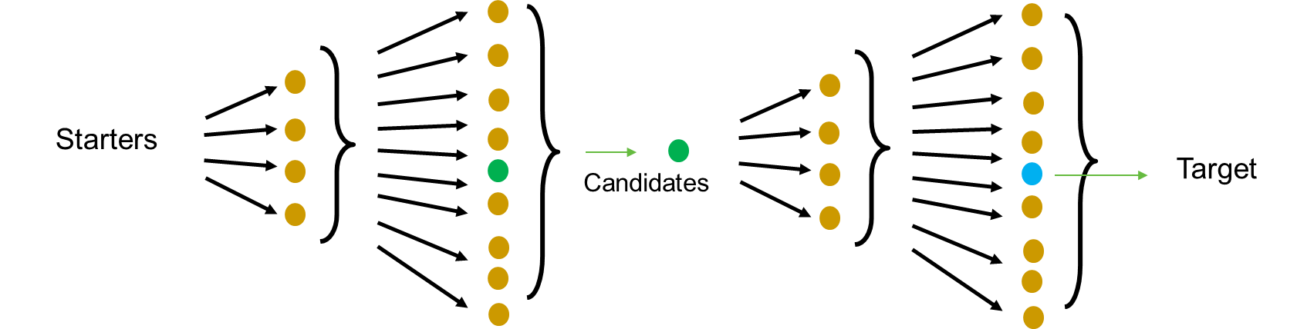
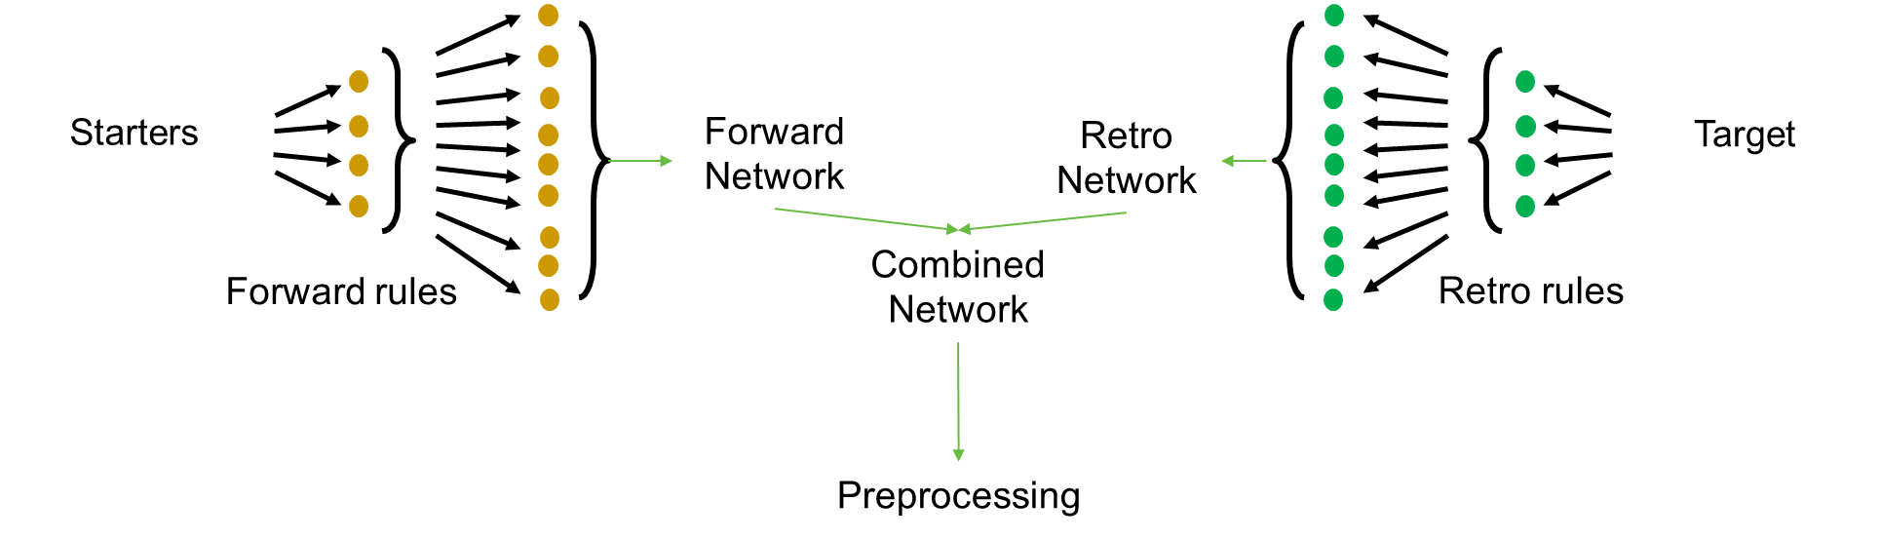
Combining forward & retro expansions saves memory
Forward:
Retro:
Combined:

Slide 27

Q&A

Slide 28
Demo: Network expansion

Slide 29
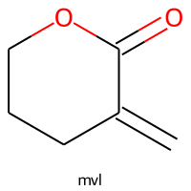
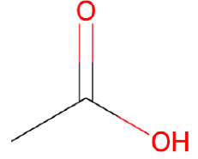
We’ll demonstrate DORAnet w/ 2 paths predicted for BOTTLE
Bio
(2 steps)
Chem
&
Hybrid
Selected feedstocks
(2 steps)

Slide 30
Overview of CASP with DORAnet
1
D
,
,
→
starting molecules
target molecules
operators
2
→
Filtering &
post-processing
→

Slide 31
Background: Filtering & post-processing

Slide 32
We saw w/ just 2 steps how quickly the reaction count grows
Bio
156,000 reactions
(2 steps)
Chem
Selected feedstocks
202,508 reactions
(2 steps)
Estimated average # of predicted reactions: 1,348 ± 91 for bio operators alone

Slide 33
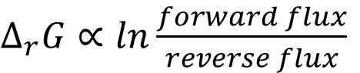
Most helpful filters: (1) thermodynamics
$Δ_{r}G∝ln\frac{forward flux}{reverse flux}$
Noor et al., 2014. PLoS Comp. Bio.
Beard & Qian, 2007. PLoS ONE
Haldane, 1930. Longmans, London.
Bio
Chem

Slide 34
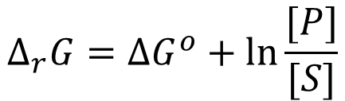
Most helpful filters: (1) thermodynamics
$Δ_{r}G∝ln\frac{forward flux}{reverse flux}$
$$Δ_{r}G=ΔG^{o}+ln⁡\frac{[P]}{[S]}$$
Noor et al., 2014. PLoS Comp. Bio.
Beard & Qian, 2007. PLoS ONE
Haldane, 1930. Longmans, London.
Bio
Chem

Slide 35
Most helpful filters: (1) thermodynamics
$Δ_{r}G∝ln\frac{forward flux}{reverse flux}$
$$Δ_{r}G=ΔG^{o}+ln⁡\frac{[P]}{[S]}$$
Property of the substrates → estimate with group contribution theory
Noor et al., 2014. PLoS Comp. Bio.
Beard & Qian, 2007. PLoS ONE
Haldane, 1930. Longmans, London.
Bio
Chem

Slide 36
Most helpful filters: (1) thermodynamics
$Δ_{r}G∝ln\frac{forward flux}{reverse flux}$
$$Δ_{r}G=ΔG^{o}+ln⁡\frac{[P]}{[S]}$$
Property of the substrates → estimate with group contribution theory
Function of substrate concentrations → optimize within physiological constraints
Noor et al., 2014. PLoS Comp. Bio.
Beard & Qian, 2007. PLoS ONE
Haldane, 1930. Longmans, London.
Bio
Chem

Slide 37
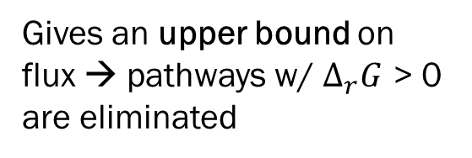
Most helpful filters: (1) thermodynamics
$Δ_{r}G∝ln\frac{forward flux}{reverse flux}$
$$Δ_{r}G=ΔG^{o}+ln⁡\frac{[P]}{[S]}$$
Gives an upper bound on flux → pathways w/ $Δ_{r}G$ > 0 are eliminated
Property of the substrates → estimate with group contribution theory
Function of substrate concentrations → optimize within physiological constraints
Noor et al., 2014. PLoS Comp. Bio.
Beard & Qian, 2007. PLoS ONE
Haldane, 1930. Longmans, London.
Bio
Chem

Slide 38
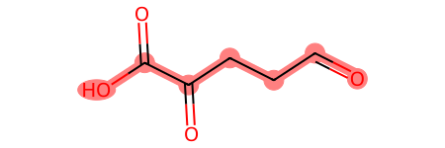
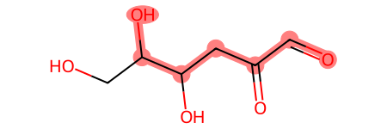
Most helpful filters: (2) structural similarity to known substrate
Predicted
Known
Reaction center MCS Score
vs.
0.64
Bio
Chem

Slide 39
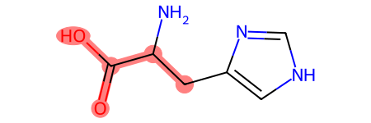
Most helpful filters: (2) structural similarity to known substrate
Predicted
Known
Reaction center MCS Score
vs.
0.64
vs.
0.45
Bio
Chem

Slide 40
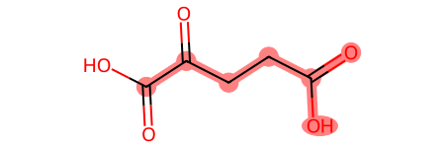
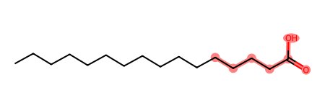
Most helpful filters: (2) structural similarity to known substrate
Predicted
Known
Reaction center MCS Score
vs.
0.64
vs.
0.45
vs.
0.39
Bio
Chem

Slide 41
Other information pulled from UniProt
Amino acid sequence
Organism
Level of evidence (protein, transcript, or homology)
EC number
UniProt ID
Bio
Chem

Slide 42
Useful Filters
Thermodynamic filter
Needs thermodynamic calculator functions from the user
Maximum atoms filter
max_atoms = {"C": 20,
"O": 10,}
Multiple reactants filter
allow_multiple_reactants
default = True for chem forward expansion
default = False for chem retro and bio expansion
Custom filters
Users can code their own filters in python with RDKit
Bio
Chem

Slide 43
Q&A

Slide 44
Demo: Filtering & post-processing

Slide 45
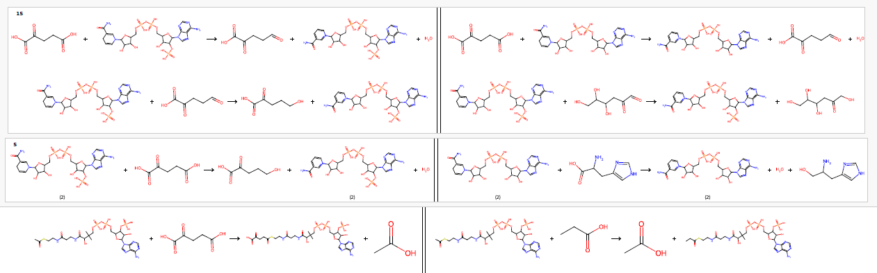
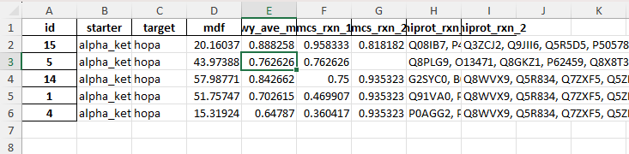
Final output documents
Side-by-side reaction drawings (.pdf)
More info on pathways (.xls)
One pathway
UniProt IDs to access more info
Predicted reaction
Known reaction
In the works: a more dynamic version that will speed up the review of this output
Bio
Chem

Slide 46
One-step Post-processing Arguments (Most Are Optional)
post_processing.one_step(
networks=None,
total_generations=1,
starters=None,
helpers=None,
target=None,
job_name="default_job_name",
search_depth="default",
max_num_rxns="default",
min_rxn_atom_economy=0.3,
weights=None,
num_process=1,
cool_reactions=None,
remove_pure_helpers_rxns=False,
sanitize=True,
transform_enols_flag=False,
molecule_thermo_calculator=None,
max_rxn_thermo_change=15,
consider_name_difference=True,
reaxys_result_name=None,
exclude_smiles=None,
reaxys_rxn_color="blue",
normal_rxn_color="black",
)
Bio
Chem

Slide 47
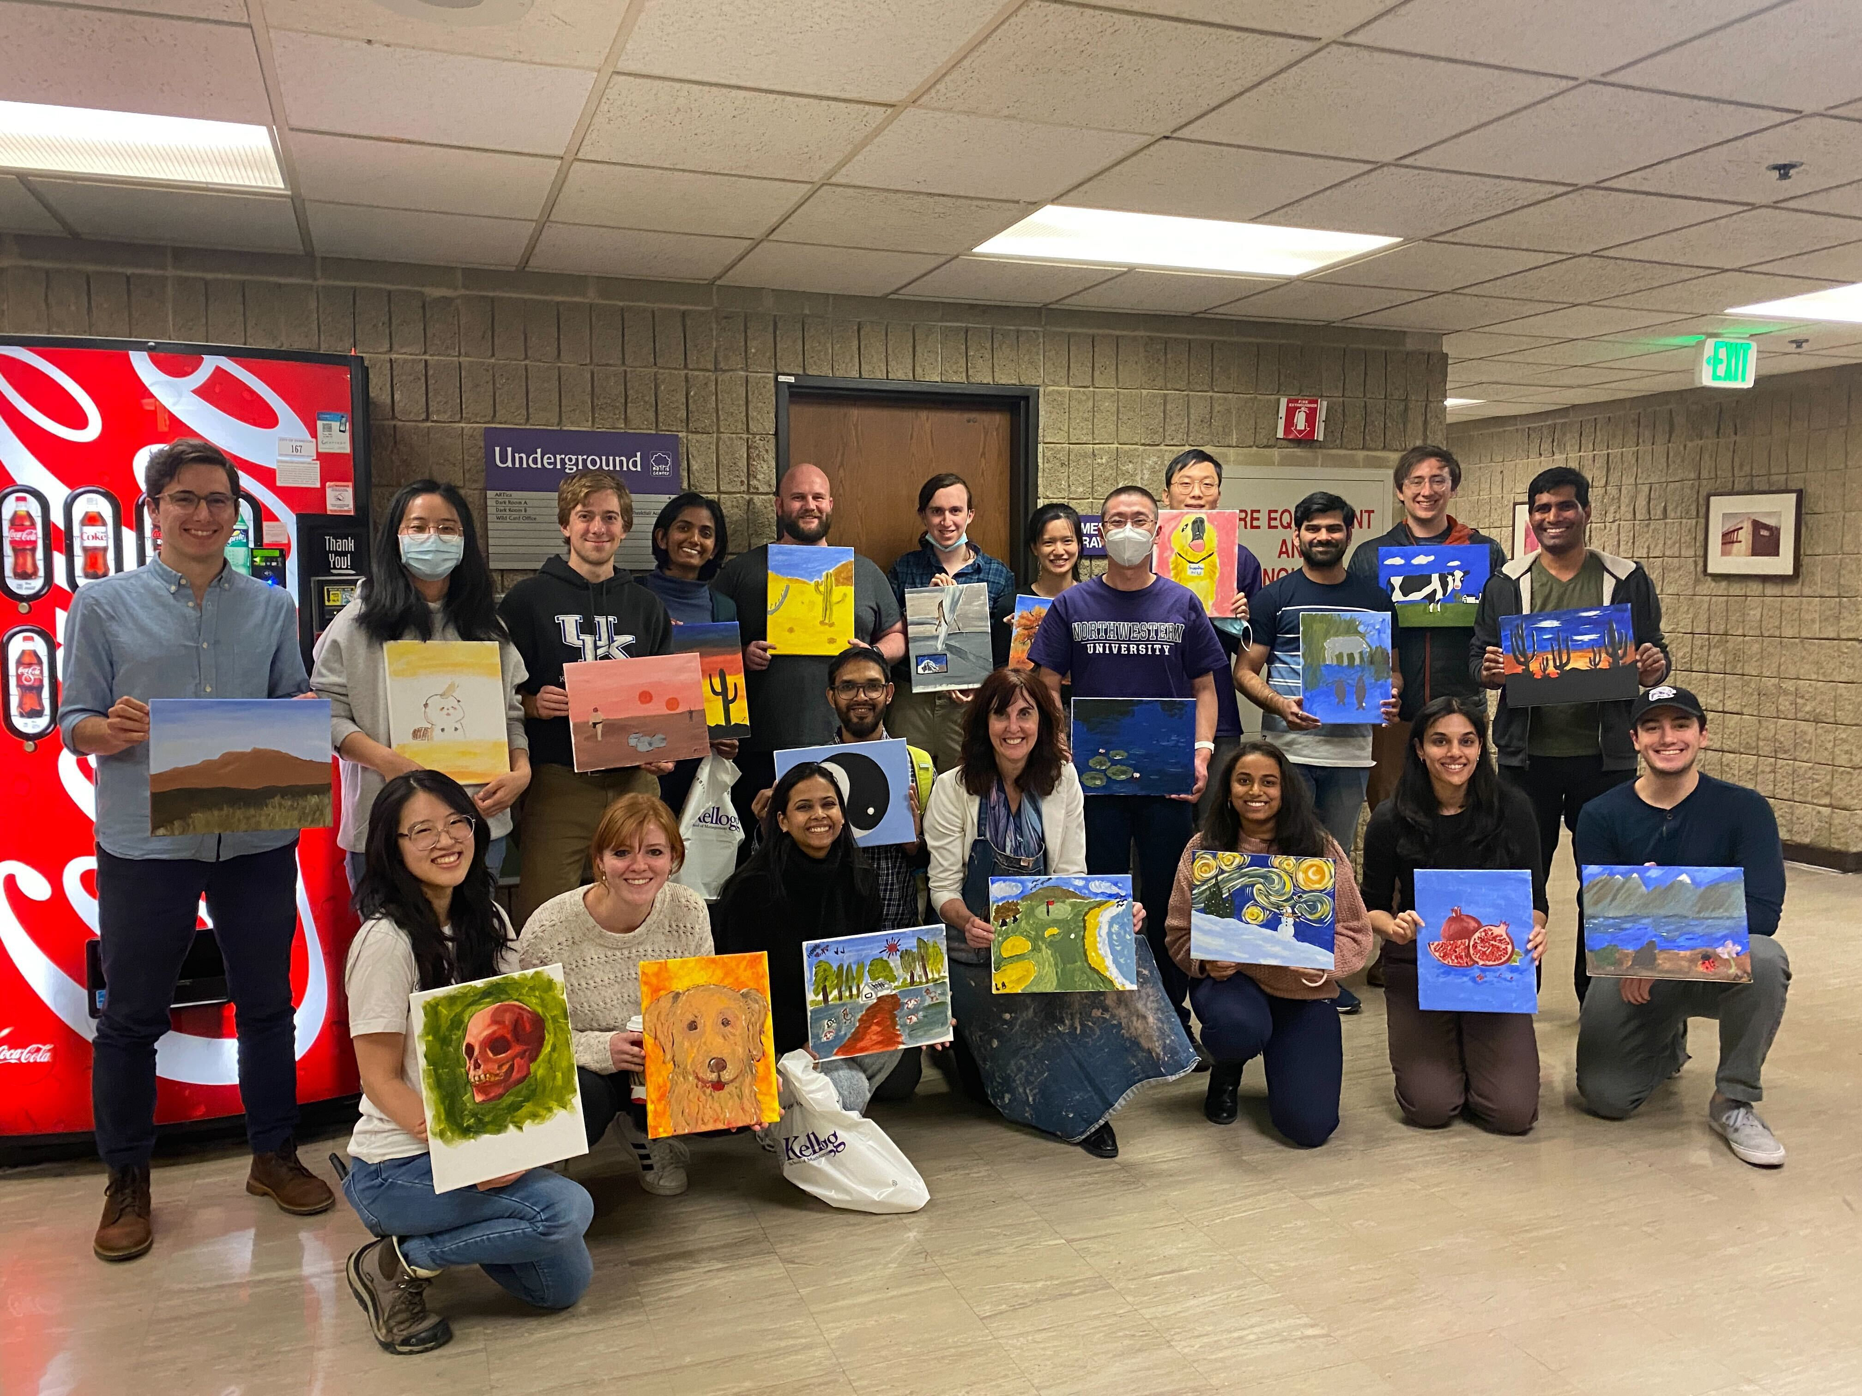


Acknowledgements
Acknowledgements
Broadbelt research group
James Gerken
BETO project

Slide 48
Q&A

Slide 49
Backup

Slide 50
Installation: DORAnet

Slide 51
Virtual Environment
Miniconda or Anaconda Installation
Download the installer
Miniconda https://docs.anaconda.com/free/miniconda/
Anaconda https://docs.anaconda.com/free/anaconda/install/
Run the installer
Follow the on-screen instructions
Use conda with command line
Linux and mac: open the built-in terminal
Windows: open the Anaconda Powershell Prompt

Slide 52
Create and Activate an Environment
If you already have an environment to install DORAnet
If you want to create a new environment to install DORAnet
conda activate your_env_name
conda create -n your_env_name python=3.10
conda activate your_env_name

Slide 53
Install DORAnet
Install
Update DORAnet (In the Future)
pip install doranet
pip install doranet --upgrade

Slide 54
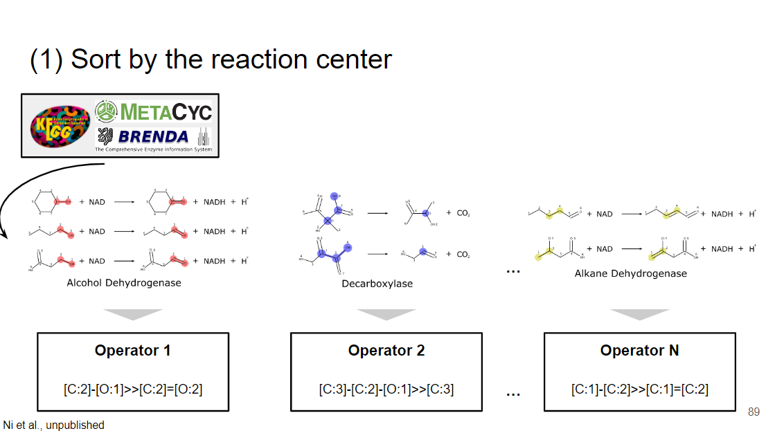
Intermediate operator construction (1)

Slide 55
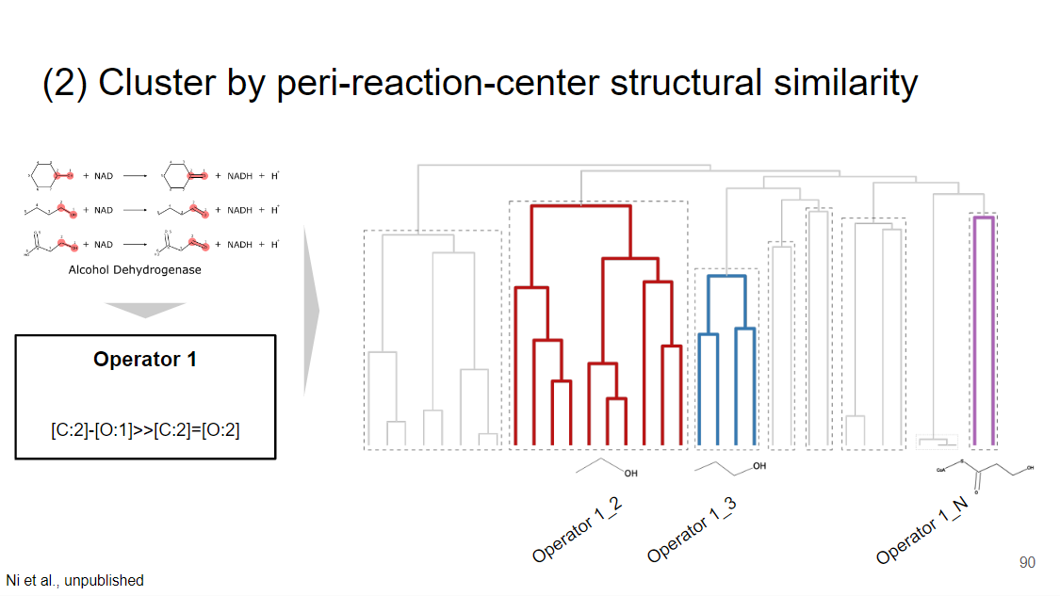
Intermediate operator construction (2)

Slide 56
Coming soon: [Hybrid pathways, kinetics…]

Slide 57
[William highlight new things in development]

Slide 58
What is DORAnet?
DORAnet is a Python framework for chemical network generation and analysis, intended to implement and extend the common functionality of tools previously used in the Broadbelt group for:
Chemo-catalytic synthesis planning
Enzymatic synthesis planning
Enzymatic product screening
Rate-based kinetic network expansion
DORAnet is licensed under the open-source Apache License Version 2

Slide 59
DORAnet Levels of Detail
Levels of Detail
GUI Layer
More accessible interface to various modules
Not yet implemented, contributions welcome!
GUI Layer
Module Layer^{1,2,3,4}
Each module implements a complex sets of assumptions about network type and structure for a particular domain application
Example: enzymatic networks use enzyme transforms and free energy filters; kinetic networks use radical rearrangements, rate-based expansion, and transition state theory
Module Layer
Core Layer
Core Layer^{1,2}
Toolbox of code implementing common assumptions shared between many domain areas
Example: a molecule is associated with a SMILES string
Interface Layer
Interface Layer¹
Definitions of relationships between fundamental objects like Molecules, Operators, and Networks
Very few assumptions about network structure
No implementation code
¹William Sprague, ²Quan Zhang, ³Stefan Pate, ⁴Geoffrey Bonnanzio

